Slide 1
Apollo: Strong consistency at scale QCon New York
Jeff Johnson
11 June 2014
Notes:
I’m Jeff Johnson, software engineer at Facebook on the Core Data group.
New project called Apollo, distributed database around strong consistency using Paxos-like protocols. Will talk about motivations, what it looks like, and how we’re exploring it at FB.
<describe Core Data>

Slide 2
Consistency
Notes:
Consistency is an interesting topic. Meaning whether or not you can see a consistent view of your updates, and whether distributed nodes come to eventual agreement.
NoSQL space has been very active in weakly/eventually consistent AP style systems, but new distributed systems around Paxos/CP haven’t seen as much interest.

Slide 3
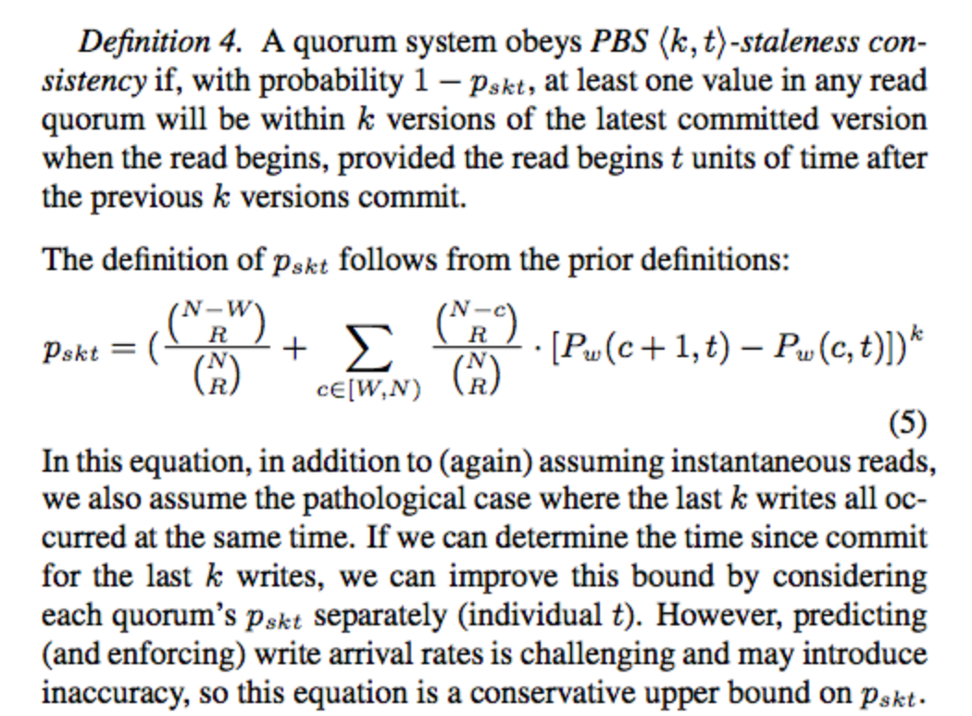
Taking sides on CAP
AP: popular but complicated
Cassandra, Dynamo
Facebook generally
uses CP-type behavior
Limited multi-master
write behavior
Notes:
AP systems (Cassandra, Dynamo) are complicated. Lots of people are using them. Describe CAP
No consistent view of data, active research topic
Facebook generally uses CP-style systems, will describe basics of replication next
==
The trend in NoSQL systems over the past decade has been mostly in distributed key/value, AP-style (in the CAP theorem sense) eventually consistent or anti-entropy type systems.
These are generally weakly consistent or eventually consistent models. Conflicts occur that have to be resolved by the client, or you can get clients losing writes that they perform.
There is often no consistent view of the database or stored data.
However, from an application developer standpoint, these systems are often difficult to reason about, and some kinds of transaction support are still desired. Facebook does not use AP-type, weakly or eventually consistent systems for most of our stored data. The gold standard for storage at Facebook is sharded MySQL still. More complicated distributed behavior is provided on top of single-node strongly consistent systems.
They provide familiar guarantees to users, but scaling them up beyond the single node provides lots of complications.

Slide 4
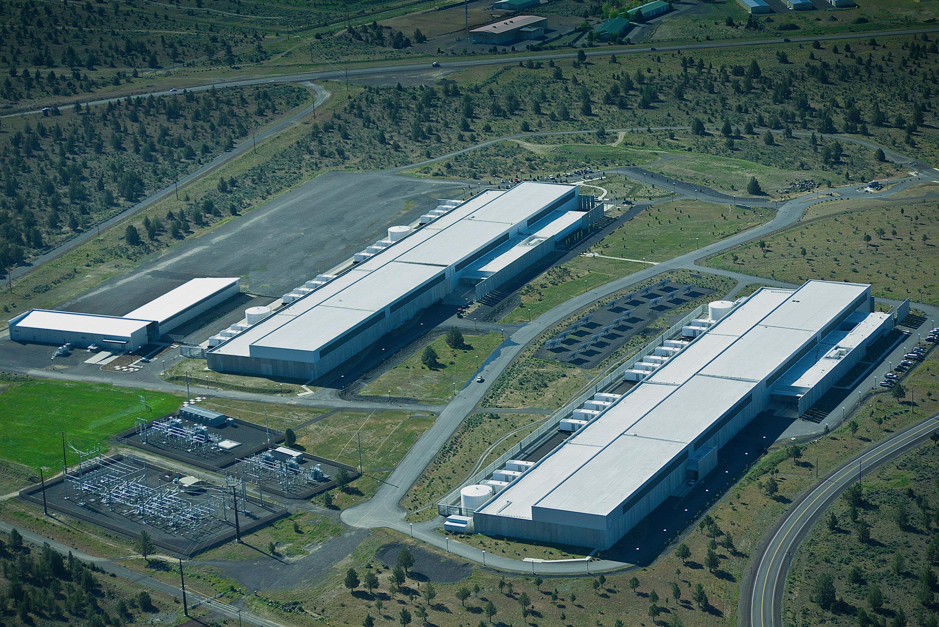
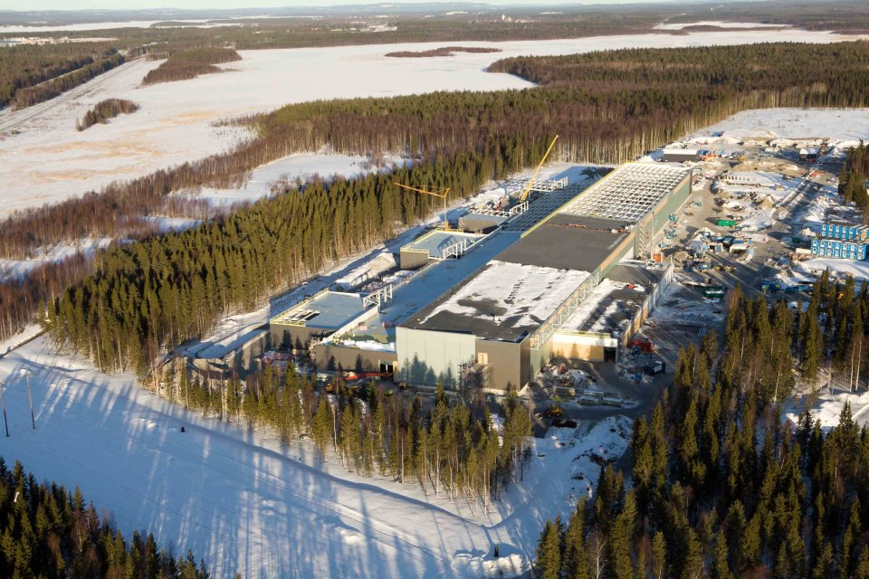
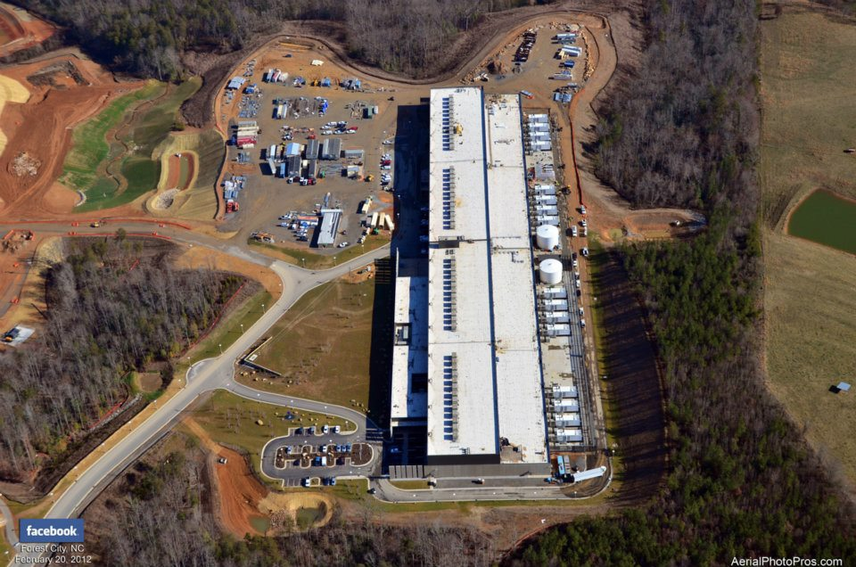

Replication at Facebook
Storage replica (slave)
Prineville, OR USA
Luleå, Sweden
Storage replica (master)
Storage replica (slave)
Forest City, NC USA
You
Notes:
Replication: sharded MySQL, but many higher-level systems too
4 DCs around world.
You -> connect to PRN.
PRN data is sharded, master. Independent buckets
Replicated to other datacenters.
Reliability issues
==
Facebook currently has 4 datacenters located around the world.
For cache locality, latency and other reasons, not all datacenters are equivalent. So a choice is made for you as far as what datacenter you will connect to. This choice is outside the scope of this talk. The servers that your web browser or mobile client will interact with are located in one of these.
Many data systems at Facebook, on MySQL, or HBase (with regions), or information services like caches or processing systems, are sharded. These are divisions of the total storage space into mostly independent buckets.
As a general pattern, a write, say a friend addition or a new photo added, is made through a master of sorts. The master works to replicate the update to other replicas in other datacenters.
The replication system used is highly variable, depending on the system. Most replication systems in use at Facebook are asynchronous, master/slave type, with full copies of data, or at least notifications of the data, in other datacenters.
The master will coordinate the writes out to other datacenters. However, masters can fail, and the internet can fail, causing partitions. The master/slave type replication suffers data unavailability and inconsistency issues. This problem elsewhere has generally led to the development of weakly or eventually consistent systems for storage.

Slide 5
Replication at Facebook
Read-after-write semantics (desired)
Write through a single master
Sticky except for failure
Replicas duplicate data
Few conflicting writes (except for failure)
Limited transaction support, but
(ideally) atomic updates within a shard
Notes:
The Facebook infrastructure has lived with these restrictions for a long time.
Our graph data storage and caching system, called TAO, provides many of these guarantees listed.
Some of these guarantees are also desired by other data replication systems at Facebook, like those used for Facebook message data.
However, one unifying factor is that oftentimes it is rare that multiple people accessing multiple datacenters need to have write access to the same objects at the same time. Much of Facebook data has single-writer, multiple-reader style access.
Specialized systems for distributed CRDT-style counters and the like have been provided independently. But most of the replication used at Facebook has been of the master/slave async or semisync type.

Slide 6
What we like
Some kind of atomic transaction on data
Acknowledged writes should be eventually visible and not lost
3
17
17
19
19
Notes:
2 guarantees that we ideally want.
The kinds of atomic operations that are available can vary widely, as well as the scope of what is allowed to be in the transaction. Possible to represent all kinds of complicated data structures, such as maps, deques and priority queues. Will discuss @ FB later.
2: don’t lose ack writes. Many NoSQL systems don’t offer this option, and it is problematic under last-writer-wins, where writers can’t serialize their actions. This is still subject to minority node failure and temporary partitions.
It is a lot easier to provide these kinds of guarantees based on a CP-type system.

Slide 7
Problems with CP
Missing ‘availability’ (A of CAP)
Not a significant issue* in local datacenter
Is an Internet-wide issue
OK
OK
Notes:
World only pick 2, many people look at AP. R/W availability
However, for Facebook’s architecture, availability (or lack thereof) is not a substantial problem in your local datacenter. Can write to 1 node, can write to N. Single node or rack switch. Want to always broadcast.
Writes across the Internet, gonna have bad time.
Can you expose limits where needed? Mix AP in? On top of a CP layer?

Slide 8
Building a new system
Facebook has survived with CP
Delayed cleanup on failure usually OK. You’ll live
AP is cool, but hard to reason about
Can you:
Make better CP-style building blocks?
Solve AP-style problems across CP groups?
Notes:
Facebook has survived with CP.
Errors are inevitable, but you can delay cleanup. Reads can be stale, writes may fail.
AP is cool, but not easy to write a complicated system.
Build a better CP building block
Use it to solve problems
==
Starting with a more strongly consistent system, there are ways that you can claw back some read or write availability under partition or failure by layering APIs and protocols on top.
You can choose what updates need to be consistent with each other. Not every update need fit within one ordered chain. A global snapshot read is often not needed.
Readers don’t necessarily have to read the latest data. Facebook replication lives with this of course; a reader hitting a different datacenter sees a different view of the data, and the cross-shard updates they see are inconsistent.
How can you recognize that writers are attempting to write based on old state? What kinds of atomic updates, if any, do you want to support?
What kinds of data conflicts can you tolerate if you wanted multiple writers?
Global snapshot reads of data are often not needed. It is rare for most web-site oriented tasks where you don’t know the kinds of data that you want to read and write up front.
At the very least, many tasks want the ability to atomically modify pieces of data. These can be used to implement things akin to primary key constraints.
Cross-dependencies are more difficult. Consider a distributed MySQL implementation. How do you atomically add something to one node conditional on data being in another node?
At scale, many such systems are effectively sharded, and the boundaries are hard to cross. NoSQL systems have tended to go down the route of throwing everything in one pool, but in obtaining scale through loose cross-dependencies or upon sharding (Hbase regions).
There is some research that is beginning to wind its way into production systems to allow you implement limited forms of cross-shard transactions. COPS is a system that Wyatt Lloyd, a postdoc researcher at the Facebook NY office, has written some papers about. RAMP is another interesting method recently presented out of Berkeley for some kinds of atomic cross-shard transactions. (Read-atomic, multi-partition)
CRDTs, commutative/convergent replicated data types, are another method. These place lots of limitations on the kind of data that you can represent though.
However, most applications only really need this for a subset of your data. If your application is within one datacenter, as long as your have replicated data, you can work with strong consistency.

Slide 9
Apollo
Notes:
Apollo is an attempt at staking out another point in the space of distributed storage systems.
There’s no claim that any one distributed storage system is the final say for any choice; there are always tradeoffs, but I think Apollo is about creating a framework around strong consistency that allows you to express some weaker consistency options across datacenters or the Internet.
The idea is that we wanted to write something relatively simple that is strongly consistent, and use that as a building block for larger components. It is in large part based on some of our experiences with HBase, and trying to replicate single-node storage systems like RocksDB.

Slide 10
Apollo
100% C++11 on Thrift2
Storage built around hierarchy of shards
Paxos-style quorum protocols (CP)
Server 2
Server 1
Server 3
Notes:
Apollo is written entirely in C++11 using the Thrift2 RPC framework (Facebook’s extensions to it)
Is a sharded storage system, with different buckets for different pieces of data, rather akin to Hbase region servers.
Taking a different approach, we decided to make a system out of a quorum consensus protocol like Paxos.
We build the quorum using collections of servers, typically 3, that we call a shard. This is the core building block of Apollo.
If you aren’t familiar with Paxos, this kind of data replication is tolerant to minority server failure. You can run a shard of any number of servers, odd ideally, but in order for an update to be accepted it must be voted on by a majority of servers within a shard.
In order for an update to complete, it will have to make its way to a majority of servers first.

Slide 11
Shards as a building block
HDFS blocks : HBase :: Shard quorum : Apollo
Notes:
Build system out of collections of shards.
Analogy: HDFS. More control over the storage, strong consistency, atomic operations
1000s of shards. Hierarchy of shards.
Internal logic runs in a FT manner
Always availability issues, don’t sweep under rug. Shards are independent.
What kind of storage system is Apollo trying to be?

Slide 12
Sweet spot
Online, low-latency storage
Flash, in-memory
Atomic transformations: “data structure”
Data size: 1 B – 1 MB. Total size: 1 MB – 10+ PB
3 servers – ~10K servers
Separation of concerns
same DC, cross-DC, cross-shard
Notes:
The sweet spot that Apollo is initially aiming for is online, low-latency storage. Especially with flash and in-memory, though spinning disk can work too.
We care a lot about flexibility of API, especially giving people the power of atomic transactions. We’re not just a K/V store, though we’re not “document oriented” or the like. We’re data structure oriented – strings, sets, maps, queues, trees, etc., like Redis, but hopefully stronger.
Storage size: small to lower large. Not for data archiving. Requires replicas of data. Erasure coding, log-only replicas and the like are something we’re considering for larger scale.
We expose to the user some considerations of datacenter and shard placement.
What does the building block look like?

Slide 13
Building from blocks
Notes:
Let’s go over the components of a shard.

Slide 14
Shard components
Part | Comments
Consensus protocol | Raft
Storage | RocksDB MySQL
User storage primitives | read() / write() binary value, deque, map, pqueue CRDT types
User code execution | Persistent, replicated state machines (FTSM)
Notes:
4 components.
1. Raft, Stanford, strong leadered. Compare with Paxos. Looking at leaderless multi-Paxos.
2. Persistent storage, committed actions written. Not just K/V. RocksDB (is KV but not necessarily exposed as such), MySQL. Multiple indices, B-Tree, etc.
3. User storage APIs. Data structure, atomic. CRDT types
4. Code execution: fault tolerant
Talk about Raft next

Slide 15
1. Consensus Protocol
Raft: Strong leader consensus protocol from Stanford
Client
WAL
Follower
WAL
WAL
Leader
Follower
Notes:
A consensus protocol is about getting a distributed group of servers to agree on something. Ideally, the agreement is fault-tolerant to a minority of nodes failing (in this case, 2 out of 3), and will never revert.
Describe how Raft works (animate diagram). Client determines who the leader is, there’s a part of the protocol to determine the leader which is kind of complicated
As a rough description of Raft, a leader from a quorum is chosen using a randomized leader election protocol. All nodes know who the leader is, and are able to distinguish between old and new leaders.
Leadered protocols are pretty efficient, since we don’t need two round trips to write a piece of data.
Next slide: what we like about Raft
The Raft protocol is oriented around the log and its entries, rather than multi-Paxos which is oriented around single Paxos instances.
Once the followers receive new requests, they write them into their WAL, and return a status to the leader. Followers can add multiple entries at once; the protocol is naturally batching.
Once a leader has determined that a majority of followers have added the request to their WAL, then the request is considered “committed”. At this point, if the leader dies or any minority of nodes die, the request will survive on a majority of the remainder and will not be lost.
The leader can then immediately reply back to the client and tell it that its request has been accepted and committed. It is also free to pass the request on to any other persistent storage or code that we actually use to process the request.
A second pass is needed to inform the followers that the request has been committed, but this can happen at any later point.
Thus, the total latency for committing something is one round trip to the leader, and the maximum round trip to a follower, for whatever follower is the last one in a majority to accept.

Slide 16
Raft
Leader failure recovery well-defined
Quorum view change well-defined
My opinion: not really simpler than multi-Paxos
Notes:
I won’t get deeply into the specifics of Raft, but it has nice properties over multi-Paxos. Leader failure is well defined and easy to implement. Multi-Paxos implementations have to add a second pass to clear out old proposals upon leader failure.
Quorum view change, that is, adding and removing servers from the quorum, is also pretty well defined. This is important if you wish to physically move shards from old machines to new ones. There are some corner cases around nodes leaving and rejoining that we had to work on separately.
We’ve spent months implementing an industrial-strength version of Raft with a lot of things that aren’t in any other implementation that we’ve seen. When you add in all of the bells and whistles, counter to the Stanford idea, it really isn’t simpler than multi-Paxos.

Slide 17
Wide World of Raft
Assume network reordering everywhere; all one-way requests | Recovering from startup corruption (minority and majority failure)
Pipelining (sliding windows) leader -> follower protocol: send data without waiting for a response | Rate limiting from submission backlog (passing Raft too much data to replicate; WAL slow)
Batching / group commit | Rate limiting from commit backlog (RocksDB being slow, in leader or followers)
Asynchronous WAL reading | Log purge behavior
Asynchronous WAL writing (is possible!) | Coordinating snapshots between store and Raft
WAL corruption detection and handling | Race conditions around nodes leaving, rejoining quorum
Notes:
As an example of many things that we’ve had to add to Raft or define on our own, here are some.
Many of these we haven’t seen in other implementations or are rather indeterminate. Some of these are still works in progress.
(briefly describe some of these, but don’t dwell on it)

Slide 18
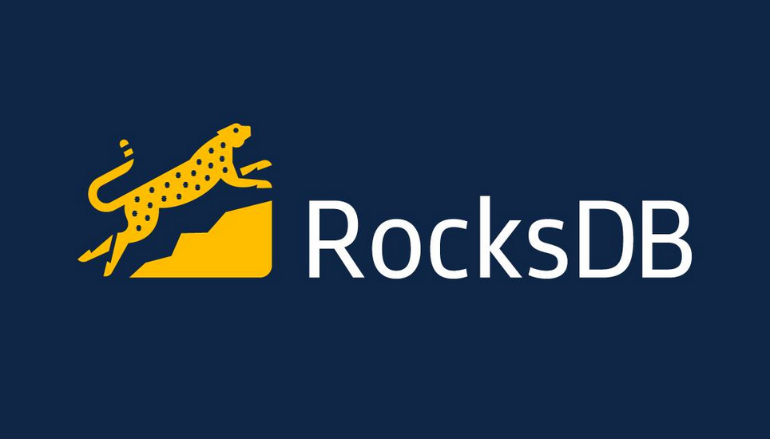
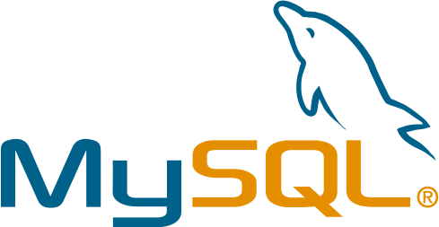
2. Persistent storage
K/V LSM local storage
(emulate other data structures)
(planned)
Notes:
For persistent storage, the main requirement is that we can embed it somehow within Apollo. This is much more complicated for MySQL, but is easy for RocksDB, which is a Facebook project built off of Google’s LevelDB.
We need the ability to snapshot the state of the storage, and ship it to other nodes. Some extensions added to RocksDB make this possible.
One problem with RocksDB is the one index; adding other indices requires adding backup values yourself. More complicated datastructures can be expressed better in MySQL.
In theory you could hook Apollo up to any storage system; graph databases, even flat files if you dare.

Slide 19
3. Client API
read({conditions : {conditions},
reads : {reads}}) ->
{conditionResults : conditionResults},
{readResults : {readResults}}
Notes:
Apollo is principally a storage system, and the third important part are the client APIs. There are only two user API calls for most of the data work.
Read allows you to express a collection of shard-local reads. You can also give it conditions that must be satisfied in order for the reads to execute. Both are arbitrary lists.
The conditions allow you to express atomic transformations on the data stored within a shard.
Read this as, if the collection of conditions are met, execute the reads atomically. Otherwise, report condition failures.

Slide 20
read() examples
read(conditions : {},
reads : {val(k1)})
read(conditions : {map(m1).contains(x)},
reads : {deque(d2).back()})
read(conditions : {ver(k1) == x,
map(m2, mk3).val == y},
reads : {val(k4),
val(k5),
pqueue(p6).top()})
Notes:
The first is an unconditional read of raw binary key/value data.
Apollo supports non-KV datatypes. It’s not a document database, but I guess in theory nothing prevents you from adding that language. All data is referenced by a key that knows the type of the datastructure it is referencing.
The second is a conditional read; if map m1 contains the key x, then we get the back value from the deque d2 if it exists.
The third contains some more complicated expressions. Priority queues are also provided.

Slide 21
write()
write({conditions : {conditions},
reads : {reads},
writes : {writes}) ->
{conditionResults : conditionResults},
{readResults : {readResults},
{writeResults : {writeResults}}
Notes:
Write is similar to read, except we also include writes to our stored data.
All of this executes atomically. If you don’t add conditions, it functions as a last-writer-wins from the client perspective. However, all writes get submitted to replication, so there is one defined order for them.
Read this as, if the collection of conditions are met, execute the reads prior to application of the writes, then update state according to the writes, all atomically. Otherwise, report condition failures.

Slide 22
write() examples
write(conditions : {}, reads : {},
writes : {val(k1) := x})
write(conditions : {ver(k1) == v}, reads : {},
writes : {val(k1) := x})
write(conditions : {ctr(c1) < 10},
reads : {map(m2, mk3).val},
writes : {ctr (c1)++})
Notes:
The first is an unconditional write. It stomps over whatever value was there before.
All keys have an explicit version defined by replication. You can use that in conditions. The second is a conditional write, and using a version, you can avoid ABA issues. This does involve a prior read to get the current version though.
The third is just another example using a non-CRDT counter type.

Slide 23
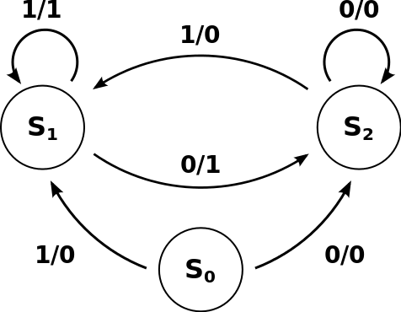
4. FTSMs
User and Apollo system code as state machines
Owned by the shard
Persistently stored
Tolerant to node failure &
partition
Notes:
This is the logic portion of Apollo. They are used for Apollo system code to coordinate actions between shards, since they are persistent until they complete, so in presence of network partitions between shards, they know there is still work to be performed and will eventually punch through them.
They live on all nodes within a particular quorum. You can choose if they execute leader-only or on all nodes concurrently.
They are logically state machines. They have explicit states. Starting a state machine, submitting input to a machine, and requesting termination are all kinds of commits that are made to replication. The state machine is resident on every replica in a shard, and their persistent state is stored in RocksDB.
They survive machine restart and the like, and migrate around as quorum membership changes.
Next: kinds of things they do

Slide 24
FTSM usage
Load balancing, data migration
Shard creation/destruction
Coordinating cross-shard transactions
Persistent notification registry; pub/sub
Notes:
Apollo uses FTSMs for cross-shard operations, or long-running procedures.
Load balancing is something that runs persistently, and executes within Apollo as a FTSM. There is no single point of failure for internal system logic.
Shard creation and destruction is also managed as a FTSM.
Cross-shard transactions can potentially take a long time to complete in the presence of network partitions, and FTSMs remain around to ensure that they eventually complete.
They are also useful for persistent notification systems or pub/sub systems. FTSMs are free to read and write from the shard local storage, and can plug in and watch operations happening on an Apollo system and trigger actions.

Slide 25
How they operate
State machines can have external side-effects
Send RPC requests to remote machines
External callbacks
Persistent state changes are submitted through replication
Notes:
Writing FTSMs are hard.
State machines can only change their persistent state via submissions to replication. You can have node-local side-effects and change local state outside of that.
For instance, you can try sending a request to a different machine. If you successfully connected to the machine, you can tell all replicas by submitting that fact to other nodes.
One issue is that due to fault tolerance, state machines can be executing on multiple nodes at once, across partitions. Thus, you have to write them as if they were executing in a duplicate fashion on every node, even though the leader may be the one executing.

Slide 26
Putting it together
Notes:
Out of many shards, we now get one storage system. Let’s see how that works in practice.

Slide 27
Putting it together
Write the hard thing once
Use it everywhere for everything
Loosely coupled system
Store directory/metadata same way as user data. Recursive properties
Notes:
This tells you what a single shard looks like, but what does an entire storage system look like?
Let’s put together shards into a working distributed storage system.
These are the principles of Apollo.
We do the heavy lifting of fault tolerance within a shard. It is the basic unit.
Run as many operations as possible within the shards using FTSMs
Try to make shards as functionally independent as possible.
Any directory information that the shards need are themselves stored in shards.

Slide 28
Finding shards
Values (binary value, maps, etc.) indexed by key
partition id:parent key:local key:type
k1 := (pid1:pkey1:lkey1:t1)
k2 := (pid1:pkey1:lkey2:t2)
=> shard(k1) == shard(k2)
Notes:
Even though we are more than a key/value store, every piece of data has a key that identifies its location.
Partitions are different regions of the key space that are isolated; this is designed for multi-tenancy.
The type of a key defines whether it is a map, raw binary value, etc. For complex data structures like maps, the read or write operation also defines the key in the map, but the entire map is stored under
Sharding is exposed somewhat in the key. There is a parent key portion and a local key portion. User data stored within a shard is analogous to a HBase region.
Two keys with the same parent key must be in the same shard. Two keys with different parent keys may or may not be in the same shard depending upon current load distribution.

Slide 29
Finding shards
G shard
P shard 1
U shard: [1:, 1:ggg]
P shard 2
U shard: (1:ggg, 1:qwx]
U shard:
[2:, 2:∞)
U shard: (1:qwx, 1:∞)
Notes:
Hierarchy of shards, similar to Hbase regions
Client caches shard location
There is one globally well-known entry point to the system, which is the global shard or G shard.
This contains system-wide information and state machines that coordinate behavior for the entire system. The G shard contains lists of current partitions (for multi-tenancy) available in the system.
So, if a client is looking up a key, we know from the key what partition it is in. The G shard tells us who owns that partition, or P shard. The client can cache this information.
P shards manage different partitions. They contain the map of the current user shard space, and how the parent keys are divided between them. They tell us what user shard to look at.
User shards are the leaf nodes. They contain user data.
The servers that the shards are hosted on can overlap. The entire system could be on three servers, say.
There is a balance between how much data is stored per shard which affects migrations and fault recoveries (having to send 100 GB to a new server), versus the number of shards which are replicated separately.
Servers typically have shards which are comparable to the number of hyperthreads on a machine (in the tens) for CPU efficiency, not considering data chunk efficiency.

Slide 30
Using shards
Multiple shards must sometimes be visible to a client
Shards atomically know whether or not they own a given range: simple client cache invalidation
P shard
U shard
Notes:
However, there is a conflict in this system.
We want to minimize cross-shard dependencies, though clients at some point need to have access to multiple shards to traverse the system. This presents unavailability issues.
Once they have performed the accesses, they can talk to shards directly.
Our principle is that there is one source of truth in the system; shards atomically know whether or not they own a given key range, so a client sending a misdirected request can invalidate its cache and look things up again.

Slide 31
Using shards
Directory shards (global, partition) also think they know where things are?
Multiple sources of truth? BAD
TXNs to move data
P shard
P shard
U shard
U shard A
U shard B
Notes:
But, there’s also a directory of shards, which is another source of truth. Data can migrate around the system due to load and the like.
How do you reconcile the two?
Clients in order to look up shards need to have visibility to multiple shards until they can cache locations. Once locations are cached, assuming data does not move, then clients have unimpeded access to the shard that holds the data.
Moving data between shards requires visibility between those shards, and between the shards and the directory server. Once the migration is complete, the dependency upon visibility is complete.
You need some kinds of implicit or explicit transactions, which have token handoffs between shards. You can suffer write unavailability until a token is properly handed off. Thus, there are still windows of time when shards need to see each other. However, migrations are much less infrequent than other operations
FTSMs remain persistent to ensure that a transaction will eventually complete once a partition heals, across server or even shard reboot.

Slide 32
Moving shards
Migrate quorum
Easy, completes at leisure. Hot shards remain hot!
A: {srv1, srv2, srv3}: [0:“”, 0:”foo”)
=>
A: {srv3, srv4, srv5}: [0:“”, 0:”foo”)
Notes:
This is only an issue if data can move, which concerns migration of ownership.
One is that the shard membership itself can change. This is done via the replication protocol. A shard knows who its members are, though the directory also has to know. The old directory information has to be changed to the new directory information.
Here, we change the servers managing shard A, which owns the range of all keys from the empty string up to the string “foo” in partition 0 to a new set of servers.
You can move servers one at a time, and update the directory information as needed. If a client happens to reach an old server, they can invalidate their directory cache and refill with new information.
This doesn’t help with hot data though, since the shards remain the same size. Only helps with hot machines.

Slide 33
Migration: moving user data
Split ownership in-place, migrate quorum
Restrictive, but greatest availability!
A: {srv1, srv2, srv3}: [0:“”, 0:∞)
=>
A: {srv1, srv2, srv3}: [0:“”, 0:”foo”) B: {srv1, srv2, srv3}: [0:”foo”, 0:∞)
Notes:
Or, you can have shards split themselves in-place. This is convenient because we don’t have to send potentially many GBs of data to new servers that are participating in a shard.
Here, we split ownership of all keys in partition 0, from the empty string to the highest possible key, to two ranges owned by the same set of servers.
Availability is not an issue because the same set of servers before and after are hosting the data; if the old shard is available, then the new shard should be.
Migrating the new shard to another set of servers than can be done via quorum changes.
The issue here is you can’t move individual hot rows to another, pre-existing shard. You can only split shards, and create more of them.
Shards can be heavyweight and hard to move as a whole, or splitting in half. The more shards you have, the more replication groups you have, which means more chatter, WALs, threads, etc.

Slide 34
Migration: moving user data
Move ownership to new/existing shard
Complicated! Availability issues!
A: {srv1, srv2, srv3}: [0:“”, 0:∞)
=>
A: {srv1, srv2, srv3}: [0:“”, 0:”foo”) B: {srv4, srv5, srv6}: [0:”foo”, 0:∞)
Notes:
Alternatively, you can try to move a portion of the keyspace from one shard to another, like in the case of a hotspot, or merging two shards together.
Here, we move ownership of all keys from “foo” to the highest possible key in partition 0 to a new shard B.
This is still an active area of investigation for us.
Load balancing tries to use all of these techniques.

Slide 35
Cross-shard behavior
Hierarchical Paxos (strong)
RAMP transactions (weak)
CRDTs: commutative/convergent replicated data types
Simplest example: distributed counters
Mirrored between shards
Sets, graphs, etc. possible but restricted.
Notes:
There is support for strong and weak cross-shard behavior as well.
Hierarchical Paxos: strong
RAMP transactions, a kind of weakly atomic (they call it Read Atomic, slightly stronger than Read Committed) transaction, can be performed by FTSMs. This is an additional level on top of the basic storage. Better than Read Committed, you want to read only fully committed values
CRDTs can be used between two shard replicas. This enables multi-master behavior; you can write in two datacenters and the values will periodically converge on a shared value based on CRDT properties.

Slide 36
Exploring Apollo at FB
Notes:
Now, we’ll describe how Apollo is being considered for Facebook.

Slide 37
Reliable in-memory DB
Raft WAL, RocksDB on Linux tmpfs
Raft protocol originally developed for this case (Stanford RAMCloud)
Notes:
Some of the initial use-cases we’re working on is to provide a reliable, in-memory distributed database for Facebook. Nothing currently serves that role at Facebook.
One of the primary limitations is the kind of storage system used. RocksDB is still a work-on-progress for in-memory performance, but we are actively working on that.
The Raft protocol, by the way, was originally developed with this use in mind.
Here are some roles this provides:

Slide 38
Reliable in-memory DB
Replace some memcache(d) usecases
Atomic transaction support
TACO: in-memory TAO (Facebook graph DB system)
Much higher write throughput
1-30 day retention vs. indefinite retention
Notes:
Memcache is used a lot as a lookaside cache at Facebook still. Some of the users of this data are more database-like than cache like. Losing data is OK, but consistent losses are bad, so it is more in the grey area between ‘cache’ and database.
Furthermore, we provide atomic transformations of data.
One popular system is an in-memory version of TAO, the Facebook graph database system that is a write-through cache for MySQL. TACO is an in-memory only version of TAO that is used for graph-like data but with more cache-like properties.
TAO handles several billion reads/sec versus several million writes/sec. TACO supports much higher write throughput, and is used for transient data. We’re considering migrating this over to a more general storage system.

Slide 39
Reliable queues
Outgoing Facebook messages for mobile (iOS, Android) and carriers (SMS)
Resident size small
High throughput
Requires 10-100s of GB backup in case of drain problems
User graph data migrations and operations
Notes:
Another initial use case we’re evaluating is to support queues for various Facebook products.
One canonical system are outgoing Facebook message notifications for web and mobile users. These are queued up until they can be delivered to iOS, Android systems, SMS, etc.
This is a high throughput system. The usual resident size of the data is small, though many GBs of storage can be required in case the queues aren’t being drained properly due to message delivery problems.
Atomicity is important.
Used in multiple datacenters.
Queues are also used in cases where fault tolerance is required.
One is is migrating users’ graph data between sharded MySQL instances. We can’t lose data here.

Slide 40
Faster analytics
Offline processing of graph data
Bucketing
Transformations
High-throughput page/click analytics
Often queue-like
Bucket based on time
Notes:
Despite saying that Apollo isn’t looking at many use cases where HBase is winding up, there are use cases where the throughput and latency that they can get with HBase isn’t sufficient.
One is certain cases for offline processing of graph data, via bucketing. Loading portions of the entire graph in and out with decent throughput is something we are looking into.
Click analytics, windowed for a certain period of time, is something being evaluated as well.

Slide 41
Questions?
jhj@fb.com
Notes:
Any questions?

